Slide 1
Crafting a Cover Letter
A Snapshot
of your
Awesomeness!
Notes:
3-D rings
(Intermediate)
To reproduce the effects on this slide, do the following:
On the Home tab, in the Slides group, click Layout, and then click Blank.
On the Home tab, in the Drawing group, click Shapes, and then under Basic Shapes click Donut (third row, second option from the left). On the slide, drag to draw a donut shape.
Select the donut shape. Drag the yellow diamond adjustment handle to the left to decrease the width of the donut shape.
Under Drawing Tools, on the Format tab, in the Size group, do the following:
In the Shape Height box, enter 4.17”.
In the Shape Width box, enter 4.17”.
Under Drawing Tools, on the Format tab, in the Shape Styles group, click the arrow next to Shape Fill, and then under Theme Colors click Aqua, Accent 5, Darker 25% (fifth row, ninth option from the left).
Under Drawing Tools, on the Format tab, in the Shape Styles group, click the arrow next to Shape Outline, and then click No Outline.
Under Drawing Tools, on the Format tab, in the Shape Styles group, click the Format Shape dialog box launcher. In the Format Shape dialog box, click 3-D Format in the left pane, and then do the following in the 3-D Format pane:
Under Bevel, click the button next to Top, and then under Bevel click Convex (second row, third option from the left). Next to Top, in the Width box, enter 5 pt, and then in the Height box, enter 5 pt. Click the button next to Bottom, and then under Bevel click Convex (second row, third option from the left). Next to Bottom, in the Width box, enter 5 pt, and then in the Height box, enter 5 pt.
Under Depth, click the button next to Color, and then under Theme Colors click Aqua, Accent 5, Darker 25% (fifth row, ninth option from the left). In the Depth box, enter 30 pt.
Under Surface, click the button next to Material, and then under Special Effect click Soft Edge (second option from the left). Click the button next to Lighting, and then under Neutral click Three Point (first row, first option from the left). In the Angle box, enter 30°.
Also in the Format Shape dialog box, click Shadow in the left pane, and then do the following in the Shadow pane:
Click the button next to Presets, and then under Outer click Offset Diagonal Bottom Left (first row, third option from the left).
In the Blur box, enter 11 pt.
In the Angle box, enter 90°.
Also in the Format Shape dialog box, click 3-D Rotation in the left pane. In the 3-D Rotation pane, click the button next to Presets, and then under Parallel click Off Axis 1 Top (second row, third option from the left).
On the Insert tab, in the Text group, click Text Box. On the slide, drag to draw a text box.
Enter text in the text box (Note: Enter three spaces before and after the text), select the text, and then on the Home tab, in the Font group, select Franklin Gothic Medium from the Font list and then select 24 from the Font Size list.
On the Home tab, in the Paragraph group, click Center to center the text in the text box.
Select the text box. Under Drawing Tools, on the Format tab, in the WordArt Styles group, click Text Effects, point to Transform, and then under Warp click Can Down (fourth row, fourth option from the left).
Drag the text box onto the donut shape.
On the text box, drag the pink diamond and blue adjustment handles to adjust the amount of text warp so that it matches the curve of the donut shape.
Under Drawing Tools, on the Format tab, in the WordArt Styles group, click the arrow next to Text Fill, point to Gradient, and then click More Gradients. In the Format Text Effects dialog box, click Text Fill in the left pane, select Gradient fill in the Text Fill pane, and then do the following:
In the Type list, select Linear.
In the Angle box, enter 0°.
Under Gradient stops, click Add gradient stops or Remove gradient stops until three stops appear in the slider.
Also under Gradient stops, customize the gradient stops as follows:
Select the first stop in the slider, and then do the following:
In the Position box, enter 0%.
Click the button next to Color, and then under Theme Colors click White, Background 1 (first row, first option from the left).
In the Transparency box, enter 0%.
Select the next stop in the slider, and then do the following:
In the Position box, enter 30%.
Click the button next to Color, and then under Theme Colors click White, Background 1 Darker 15% (third row, first option from the left).
In the Transparency box, enter 0%.
Select the last stop in the slider, and then do the following:
In the Position box, enter 100%.
Click the button next to Color, and then under Theme Colors click White, Background 1, Darker 35% (fifth row, first option from the left).
In the Transparency box, enter 0%.
Press CTRL-A to select the shape and the text. One the Home tab, in the Drawing group, click Arrange, and then click Group.
Select the group. On the Home tab, in the Clipboard group, click the arrow to the right of Copy, and then click Duplicate.
Select the second shape group, and then, on the slide, drag it slightly above and to the right of the first donut shape.
Select the text in the second text box and edit the text.
Select the second donut shape. Under Drawing Tools, on the Format tab, in the Size group, do the following:
In the Shape Height box, enter 3.75”.
In the Shape Width box, enter 3.75”.
Drag the second text box onto the second donut shape.
On the second text box, drag the pink diamond and blue adjustment handles to adjust the amount of text warp so that it matches the curve of the second donut shape.
Select the second donut shape. Under Drawing Tools, on the Format tab, in the Shape Styles group, click the arrow next to Shape Fill, and then under Theme Colors click Purple, Accent 4, Darker 25% (fifth row, eighth option from the left).
Also under Drawing Tools, on the Format tab, in the Shape Styles group, click the Format Shape dialog box launcher. In the Format Shape dialog box, click 3-D Format in the left pane. In the 3-D Format pane, under Depth, click the button next to Color, and then under Theme Colors click Purple, Accent 4, Darker 25% (fifth row, eighth option from the left).
Press and hold CTRL, and then select the second donut shape and text box. On the Home tab, in the Clipboard group, click the arrow to the right of Copy, and then click Duplicate.
Drag the third donut shape and text box slightly above and to the left of the second donut shape.
Click the third text box and edit the text.
Select the third donut shape. Under Drawing Tools, on the Format tab, in the Size group, do the following:
In the Shape Height box, enter 3.33”.
In the Shape Width box, enter 3.33”.
Drag the third text box onto the third donut shape.
On the third text box, drag the pink diamond and blue adjustment handles to adjust the amount of text warp so that it matches the curve of the third donut shape.
Select the third donut shape. Under Drawing Tools, on the Format tab, in the Shape Styles group, click the arrow next to Shape Fill, and then under Theme Colors click Olive Green, Accent 3, Darker 25% (fifth row, seventh option from the left).
Also under Drawing Tools, on the Format tab, in the bottom right corner of the Shape Styles group, click the Format Shape dialog box launcher. In the Format Shape dialog box, click 3-D Format in the left pane. In the 3-D Format pane, under Depth, click the button next to Color, and then under Theme Colors click Olive Green, Accent 3, Darker 25% (fifth row, seventh option from the left).
Select the first donut shape. On the Home tab, in the Drawing group, click Arrange, and then click Send to Back.
To reproduce the background effects on this slide, do the following:
On the Design tab, in the Background group, click Background Styles, and then click Format Background. In the Format Background dialog box, click Fill in the left pane, select Gradient fill in the Fill pane, and then do the following:
In the Type list, select Linear.
In the Angle box, enter 270.
Under Gradient stops, click Add gradient stops or Remove gradient stops until two stops appear in the slider.
Also under Gradient stops, customize the gradient stops as follows:
Select the first stop in the slider, and then do the following:
In the Position box, enter 31%.
Click the button next to Color, and then under Theme Colors click White, Background 1 (first row, first option from the left).
In the Transparency box, enter 0%.
Select the next stop in the slider, and then do the following:
In the Position box, enter 100%.
Click the button next to Color, click More Colors, and then in the Colors dialog box, on the Custom tab, enter values for Red: 200, Green: 201, Blue: 193.
In the Transparency box, enter 0%.

Slide 2
Imagine, the hiring manager
who MUST wade through a GInormous stack of resumes to find the 1 0R 2 candidates who best fit her company’s available jobs…

Slide 3
Now consider how hard it is for your poor little resume to stand out from the others in that ginormous pile.
OY!

Slide 4
You may be wondering…

Slide 5
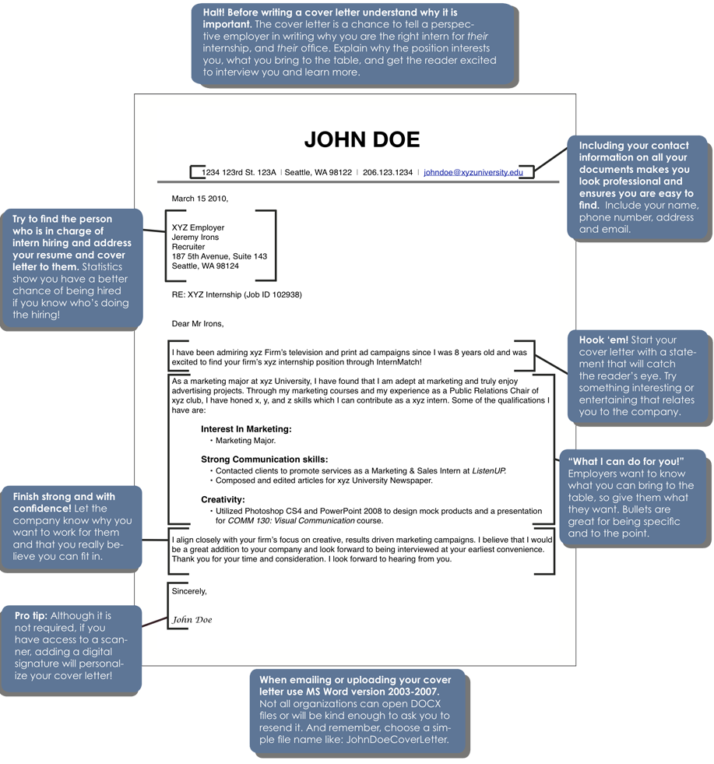
Never Fear…
The Cover Letter’s Here!

Slide 6
Your AWESOME Cover Letter Will..
make a positive first impression on that overwhelmed hiring manager by…

Slide 7
Offering the employer a verbal snapshot of YOU!
How do YOUR skills match their job requirements?
What will you add to the work environment?
What makes you the perfect choice for this particular job?
Why are you excited about working in this position at this company?

Slide 8
An EFFECTIVE Cover Letter…
may include information, like
your contact information, and how your skills suit the job, BUT…
YOUR individual
shines through!!

Slide 9
Introduces you to potential employers and motivates them to read your resume
Highlights your strengths in relation to their job responsibilities
Demonstrates your writing and communication skills and your professionalism and courtesy
Reveals your personality and enthusiasm for the job, the company, the field of work
A Cover Letter Serves four main purposes:

Slide 10
To Figure Out WHICH Area of Your AWESOMENESS to Highlight in Your Cover Letter…
Read the employer’s job description carefully.
Decide which of your skills and experiences best suit the employer’s needs.

Slide 11
Share Your Enthusiasm! For the job, the company, the field of work…

Slide 12
And Don’t Forget to PROOFREED !

Slide 13
Did you catch how jarring that misspelled “Proofread” was in the last slide?
Make your first impression a good one!
HA!

